Slide 1
Deep Neural Networks
Getting your matrix
dimensions right

Slide 2

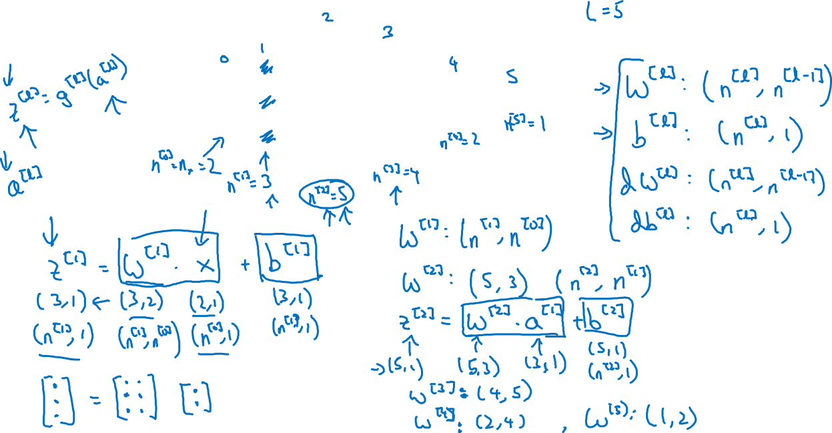



Parameters $W^{[l]}$ and $b^{[l]}$
$$x_{1}$$
$$\hat{y}$$
$$x_{2}$$

Slide 3
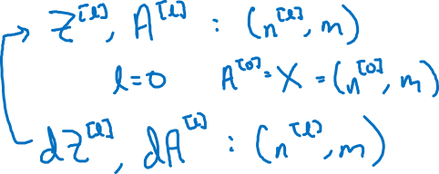
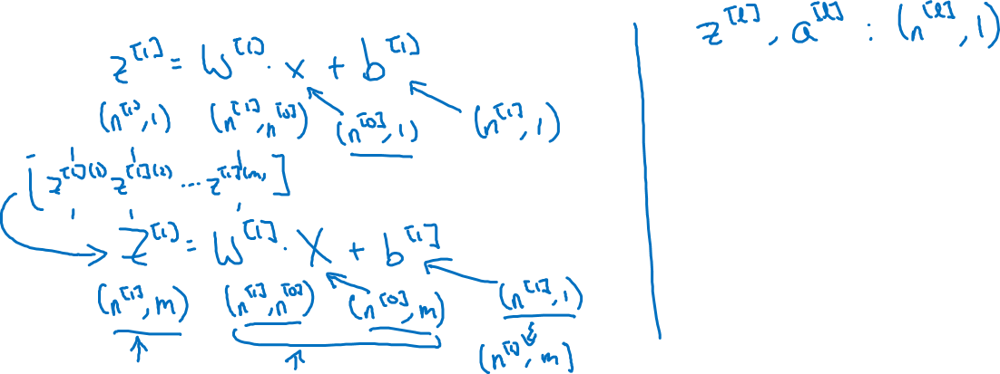
Vectorized implementation
$$x_{1}$$
$$\hat{y}$$
$$x_{2}$$

Slide 4
Deep Neural Networks
Why deep
representations?

Slide 5

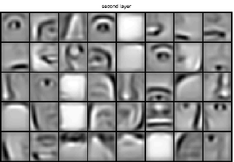
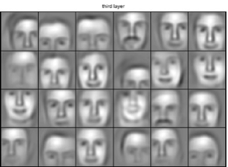

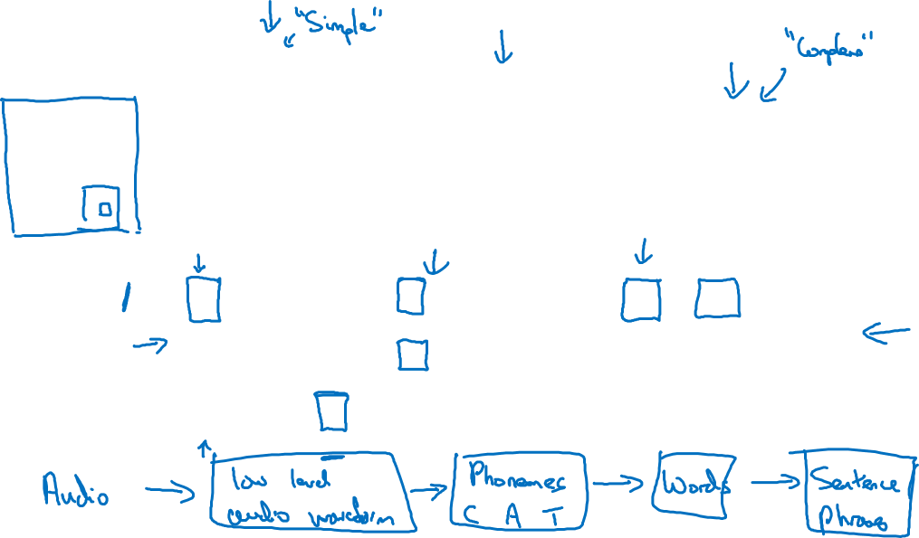
Intuition about deep representation
$$\hat{y}$$

Slide 6
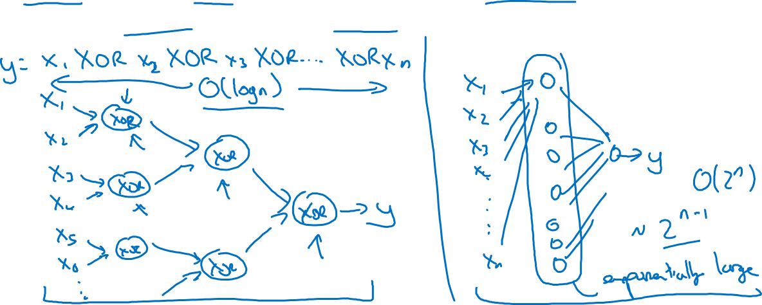
Circuit theory and deep learning
Informally: There are functions you can compute with a “small” L-layer deep neural network that shallower networks require exponentially more hidden units to compute.

